Slide 1
Pi, Python, and PaintbalL? Innovating with affordable Tech
By: Barry Tarlton
btarlton@gmail.com
Link to slides: http://bit.ly/pipaintball

Slide 2






My Experience/ Background
12 Years

Slide 3

GOALS…
Understand a little of what’s possible

Slide 4


GOALS…
How to get started

Slide 5


GOALS…
Lessons learned and application

Slide 6
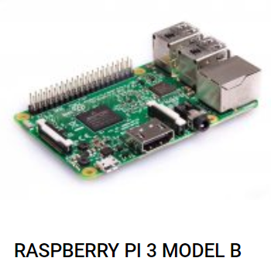

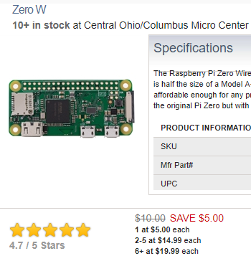
Raspberry PI
https://www.raspberrypi.org
“A small and affordable computer that you can use to learn programming.”
“The Raspberry Pi Foundation is a UK-based charity”
“Put the power of digital making into the hands of people all over the world, so they are capable of understanding and shaping our increasingly digital world, able to solve the problems that matter to them, and equipped for the jobs of the future.”

Slide 7
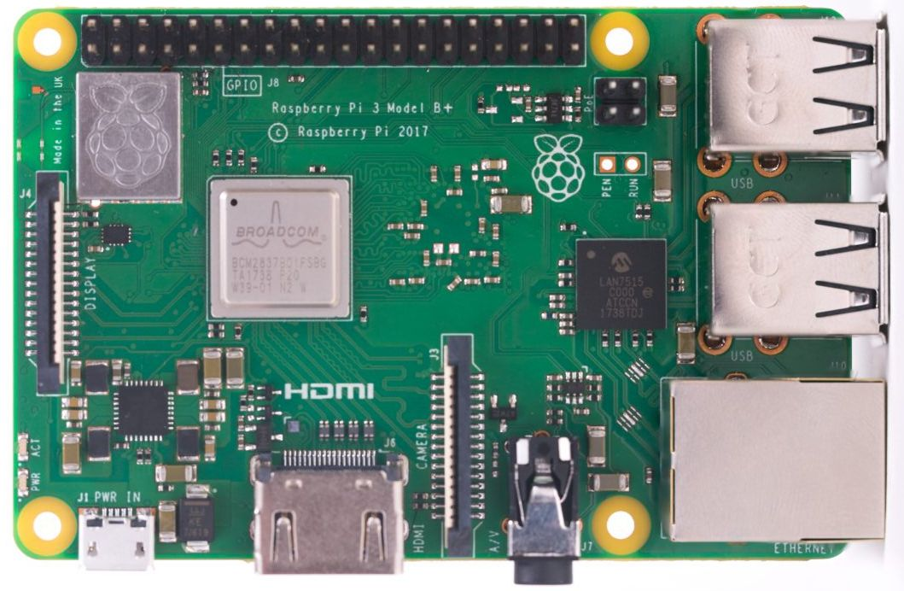
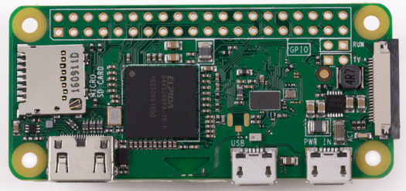
Pi Model Comparison
PI 3
PI Zero
Name | Pi 3 B+ | Pi Zero W
Price: | $35 | $10 - $15
Processor: | Quad 1.4GHz (standard Pi 3 1.2GHz ) | Single core1GHz
Memory: | 1 GB DDR2 | 512MB
USB Ports: | 4 USB | 1 micro USB
HDMI : | 1 standard | 1 mini
Audio: | 3.5mm Jack | N/A
Uses: | Desktop learning Server or Heavy processing | Less process intensive tasks that need connectivity. (e.g. Motion activated camera that uploads to the cloud)

Slide 8

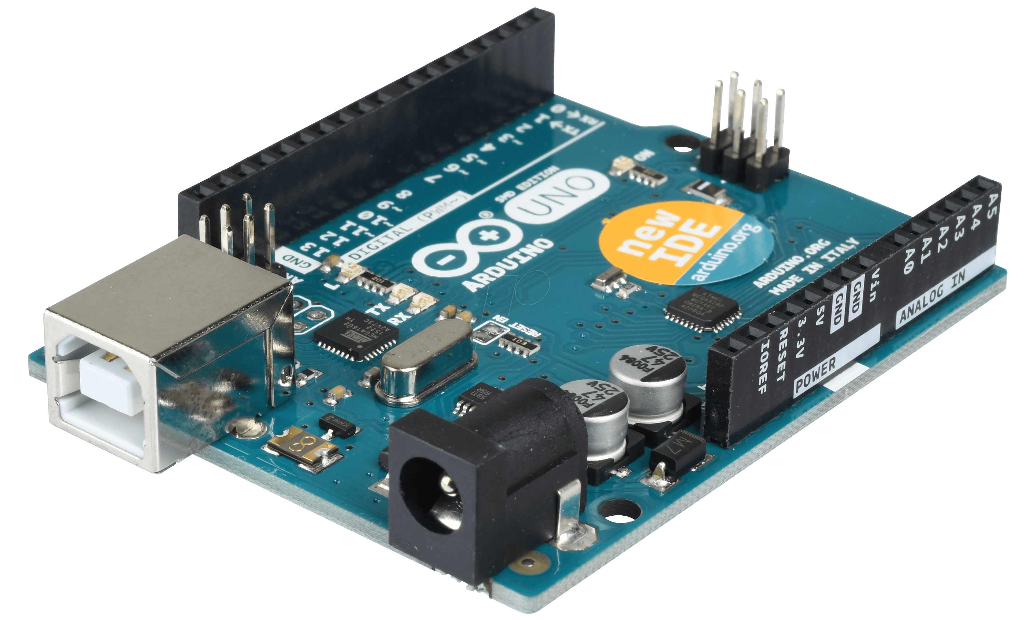
Arduino
“Open-source electronics platform (microcontroller) based on easy-to-use hardware and software.”
A microcontroller is a simple computer that can run one program at a time, over and over again.

Slide 9
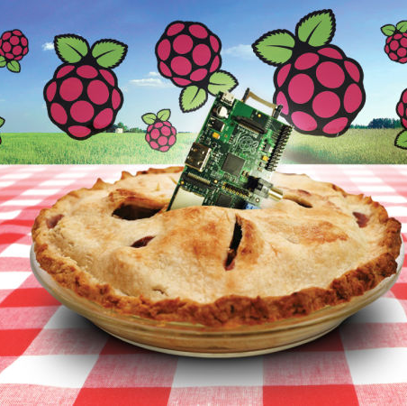

Starting a PI Project
How to use a PI?

Slide 10
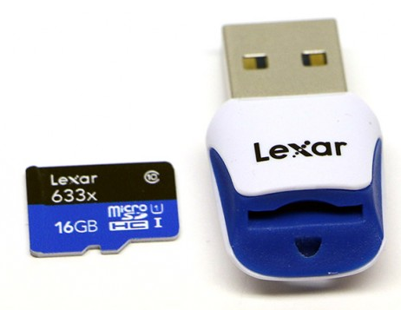
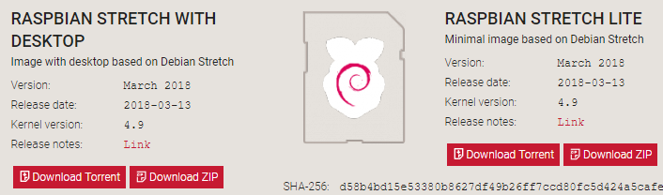
Setting up the PI
Download OS and install on MicroSD card
https://www.raspberrypi.org/downloads/raspbian/
1)
2)

Slide 11
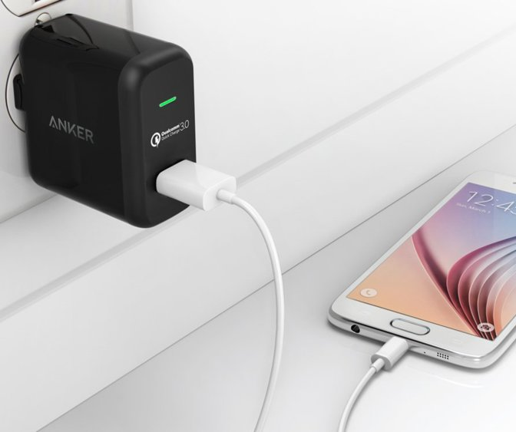
POwer
Phone charger micro USB
PC USB port

Slide 12
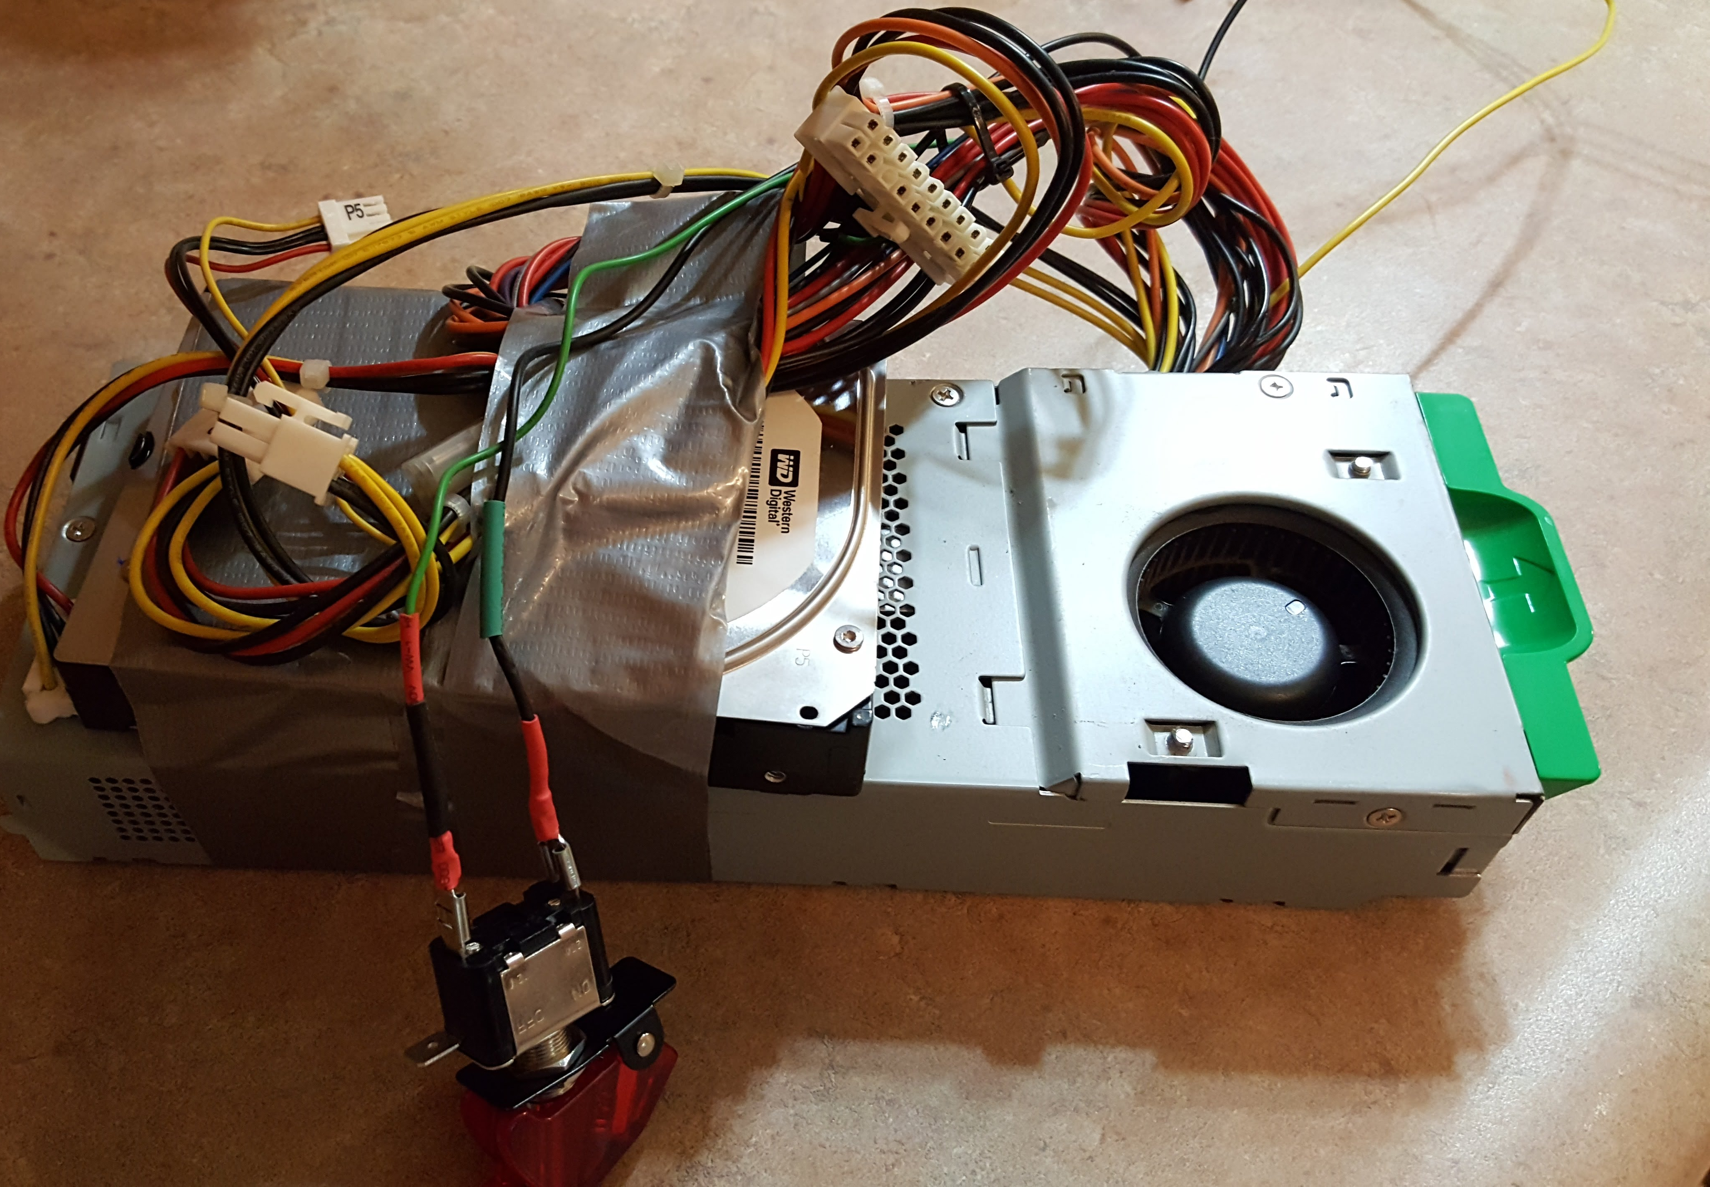
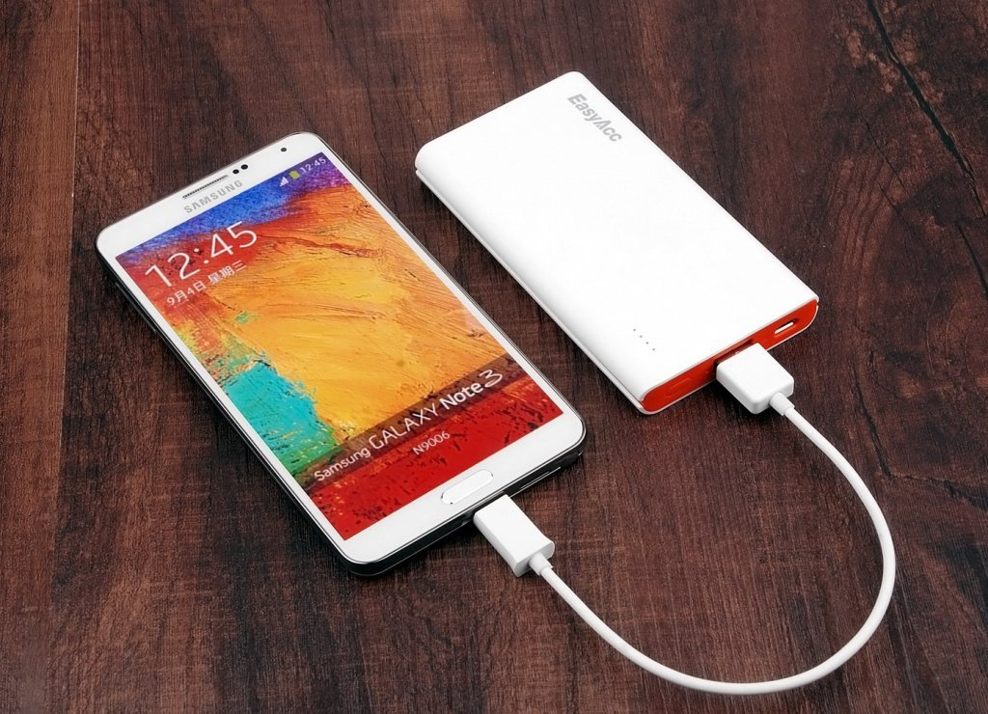
Other Power Options
Battery back up
OR anything with
5 volts DC out
Preferably 2 or more amps
Like PC Power supply

Slide 13
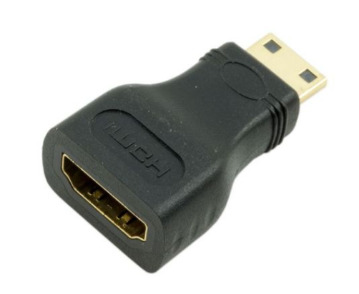
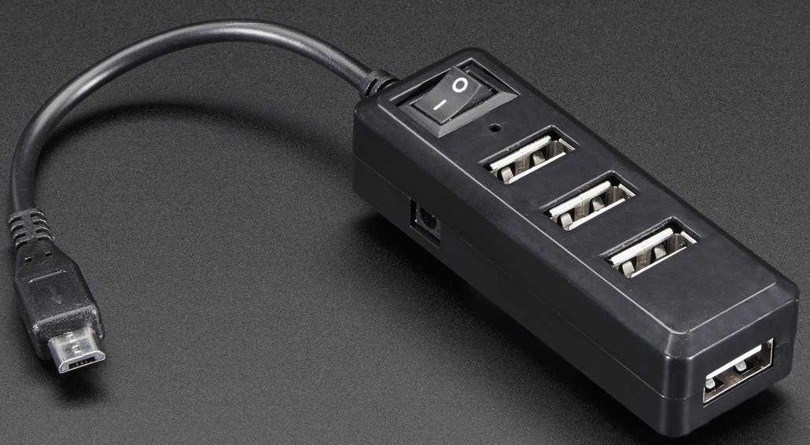
Keyboard and Display
Mini HDMI
to HDMI
Keyboard, Monitor
Mini HDMI for pi zero,
Micro USB to USB adapter/hub for pi zero
PI 3 has full size HDMI and “full size” USB
MicroUSB
To USB Hub

Slide 14
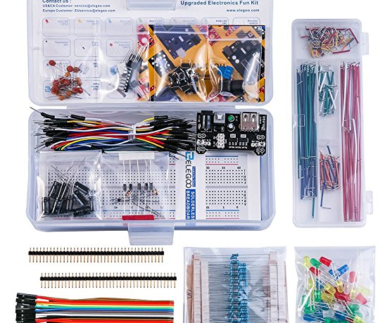
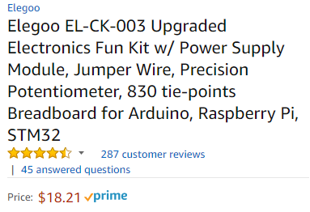
Starter Kit
Bread Board and starter kit with LEDs, wires, transistors, etc…
Elegoo EL-CK-003 Upgraded Electronics Fun Kit w/ Power Supply Module, Jumper Wire, Precision Potentiometer

Slide 15

The motivation …
My Son
My Daughter
Barry(ME)
Don Stroud

Slide 16

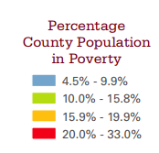

The Story
Pike County
Poor Area of Ohio
Large Drug and Alcohol Problem
Rural Area

Slide 17

Christian Youth Development
Founder:
Don Stroud
Safe environment for kids
Camping, Go-Karts, Games, and Paintball
Developing Integrity

Slide 18

Annual Ohio State Vs Michigan Game
Problem?
Running The Games
Organization
vs.
Controlled Chaos
Don & Betty Stroud

Slide 19

Problems
When do we start?

Slide 20

Is the round over?

Slide 21


I got hit,
when can I
go back in?

Slide 22
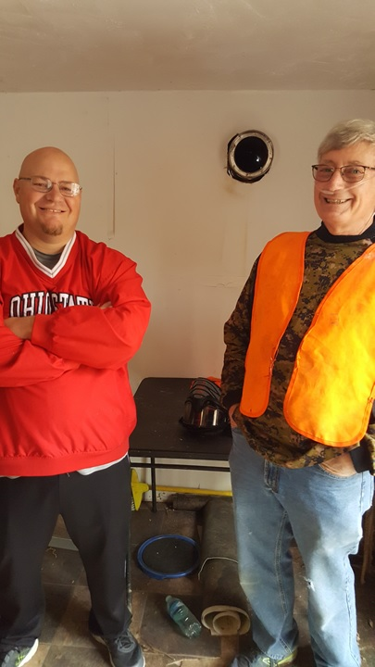




What we’ve
Tried?
Referees
With Walkie talkies
Loud
Speakers
or Airhorns

Slide 23
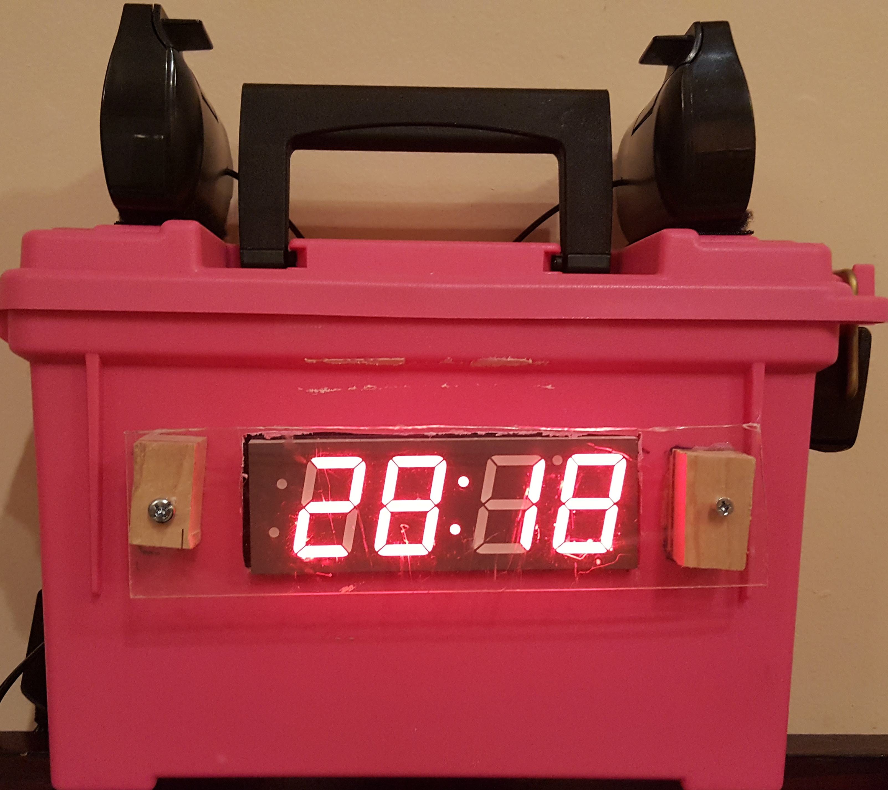
My Solution: Distributed Speaking timERs

Slide 24
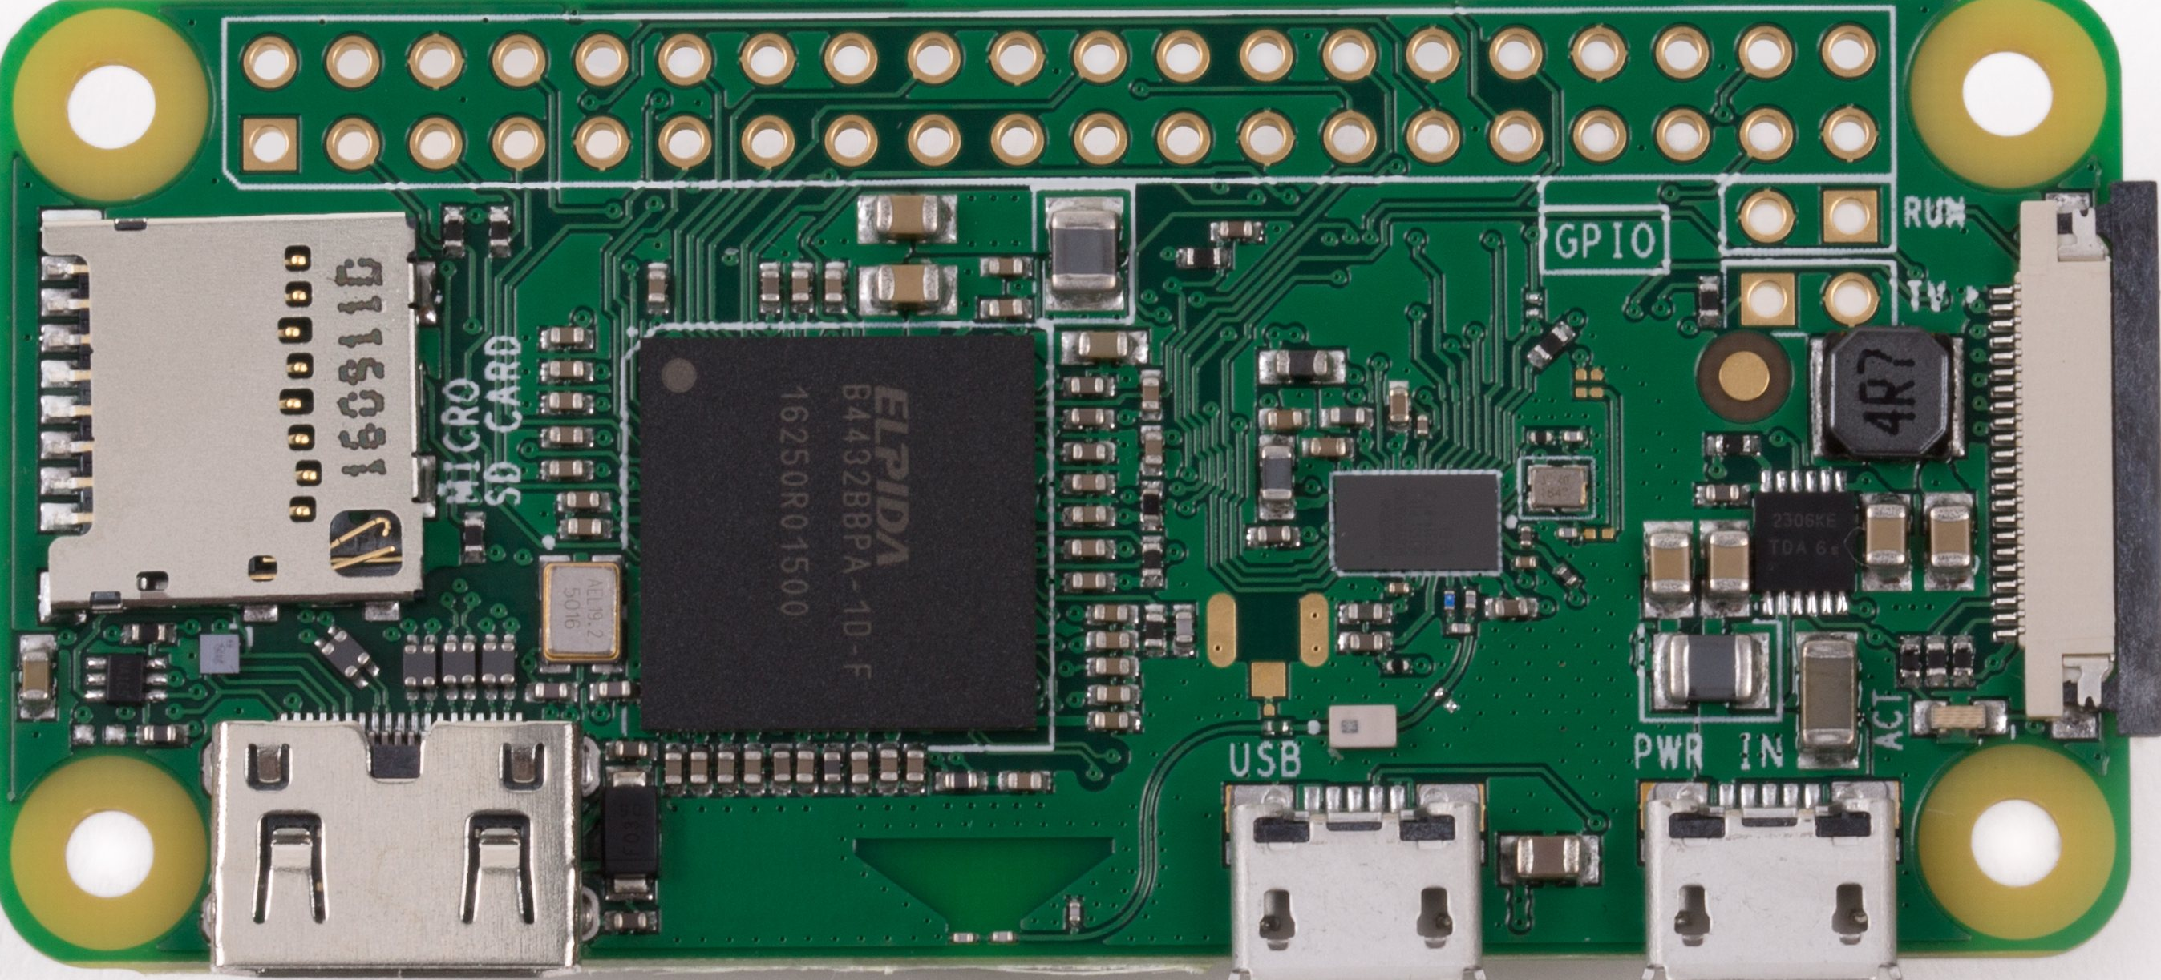

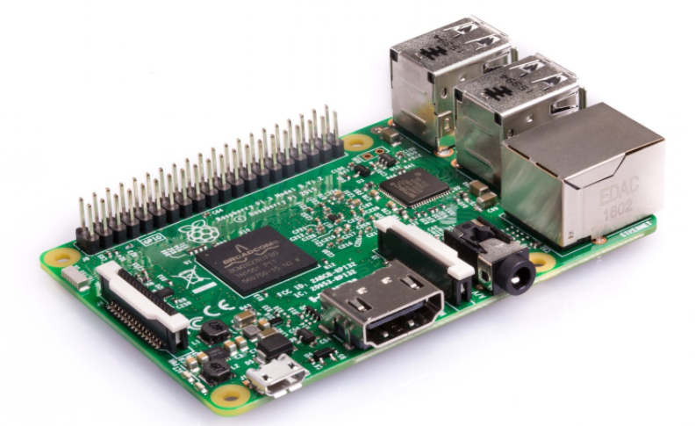
Distributed timers In the Trees
Pi Zero W
Pi Zero W
RaspeBerry Pi 3
Pi Zero W
Pi Zero W

Slide 25
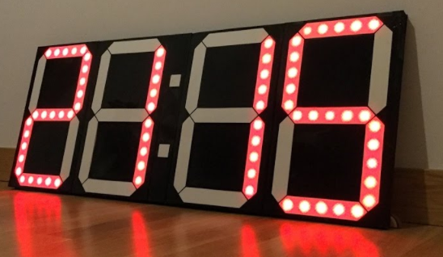
Digital Display
Clock Display for the PI
Bright (Able to see outdoors)
Readable from 15-20 feet away
Easy to Control from PI
Affordable

Slide 26
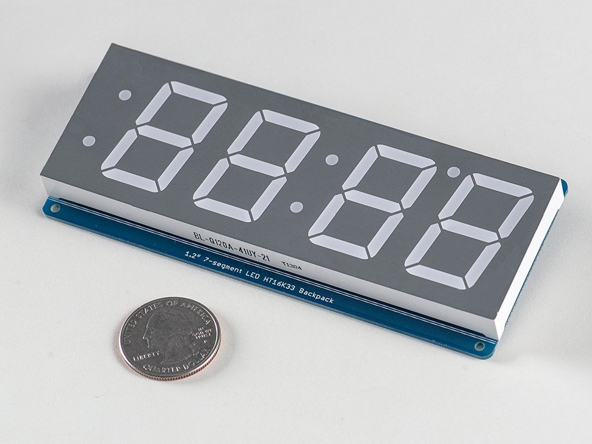

7 Segment Display
Adafruit 7 Segment Display With I2C Backpack
1.2” tall
About $20
https://chicagodist.com/

Slide 27
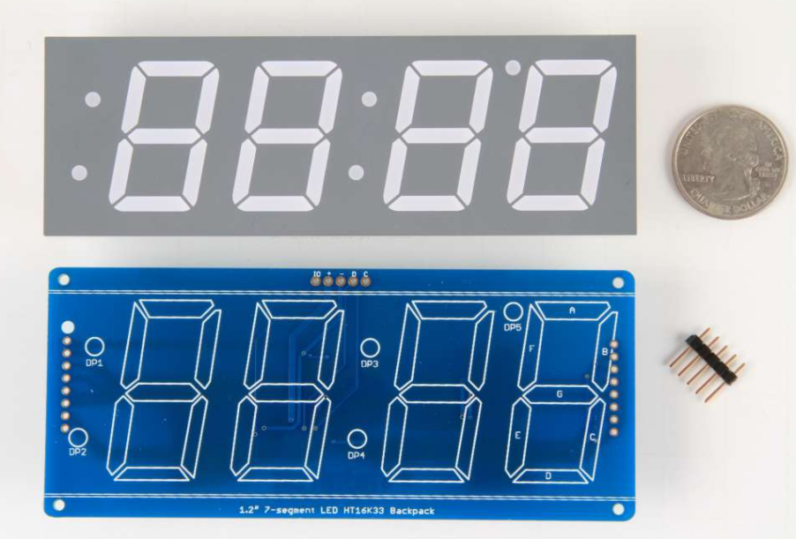
Some assembly required!!!!
“When you buy a pack from Adafruit, it comes with the fully tested and assembled backpack as well as a 7-segment display …”
WHAT!!!???
“You'll need to solder the matrix onto the backpack but its an easy task.”

Slide 28

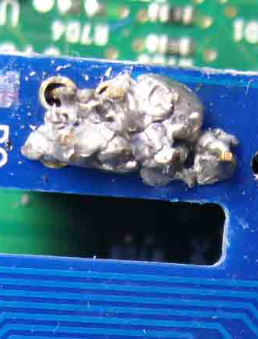
Learning About Electronics
Soldering Novice
Electronics Noob

Slide 29
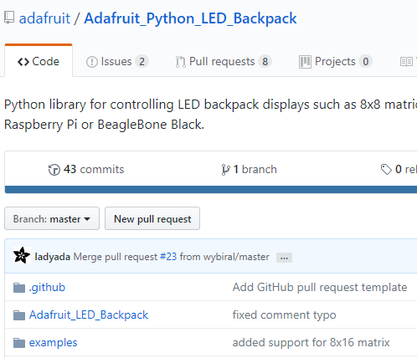
Controlling CLOCK Display
Controlling Display from Code
Only a few examples most for Arduino ☹
https://learn.adafruit.com/matrix-7-segment-led-backpack-with-the-raspberry-pi/using-the-adafruit-library
https://github.com/adafruit/Adafruit_Python_LED_Backpack
GitHub to the Rescue!

Slide 30
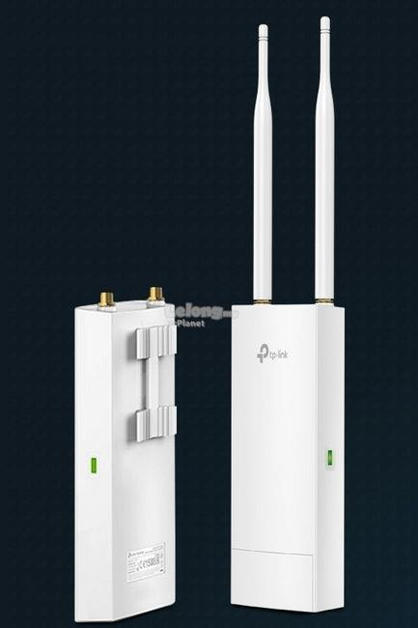

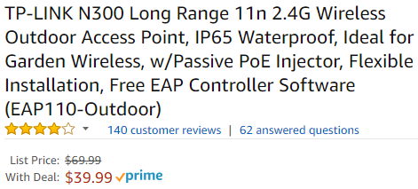
How do we communicate
Create a wireless network outside
With no internet access.
DHCP
Server
Pi Zero W
RaspeBerry Pi 3
Pi Zero W

Slide 31

Keeping Time
Synchronize watches with my Time!
How to Synchronize time (Keep all on same time)
No internet and no clock battery to retain time
Solution???
Don’t build a new one
NTP – Network Time Protocol
NTP
Server

Slide 32

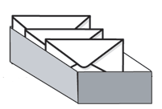
Communicating Across PIes
Mosquitto and MQTT
https://pypi.python.org/pypi/paho-mqtt
Static IP
End Time:
1:45PM
MQTT
Queue

Slide 33
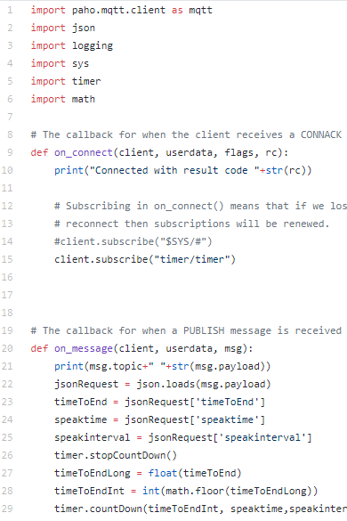
Mosquitto and MQTT
Timer
Box Code
Publish / Subscribe Pattern
If timer boxes restart, last known message still on queue, so pick up where they left off

Slide 34


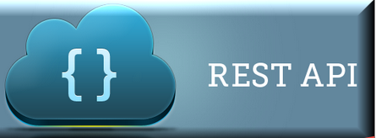
REST CALLS to RASPBERRY PIes
/timer
REST API on Server to Submit Message to Queue
Timer
Queue
Queue

Slide 35

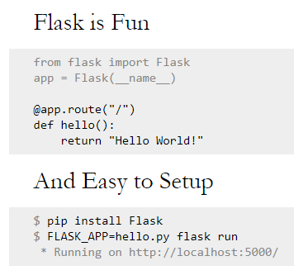
REST CALLS In Python
Flask Framework
Easy to use for HTTP request handling

Slide 36

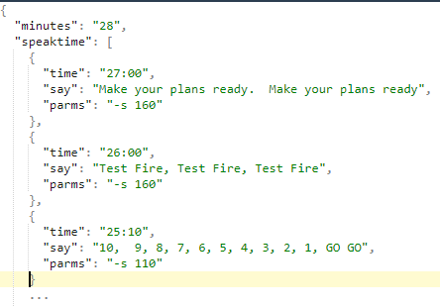
Making them talk!!!
eSpeak – Open Source Text To Speech software
Update timer message format to submit messages at specific times
http://espeak.sourceforge.net/
Request Message

Slide 37

DEMO TIME

Slide 38

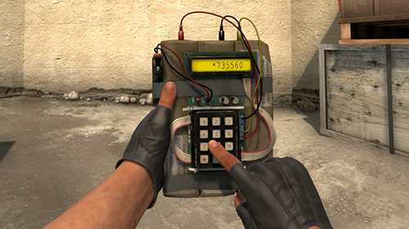
Now the Cool Stuff…
What could I do next?
Bring Video Game to Life
This Photo by Unknown Author is licensed under CC BY-NC

Slide 39
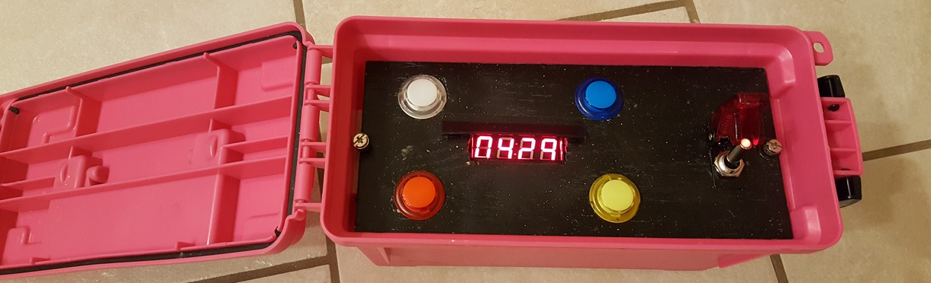
Pi Bomb

Slide 40
Video Demonstration of Pi Bomb and Distributed Timers:
https://photos.app.goo.gl/BXAWD1BYMQ3NbYVK2
Same video just on Youtube:
https://youtu.be/Y6h4PRMJcAs

Slide 41

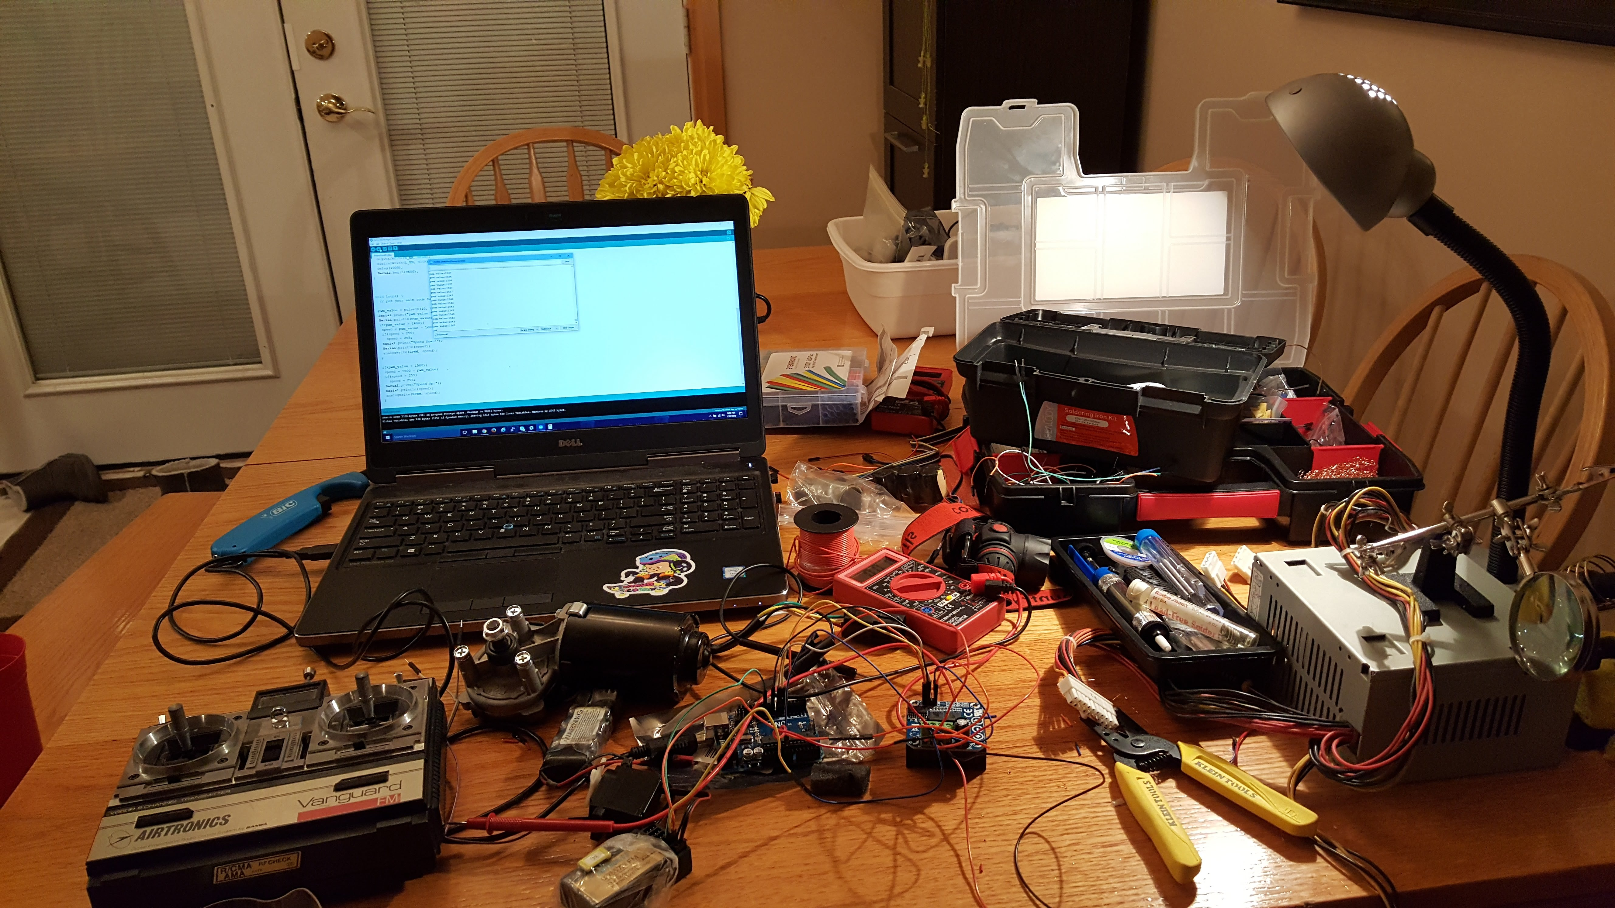
Latest Project

Slide 42
Latest Project
Windshield Wiper Motor
Arduino
Transmitter
H Bridge
Reciever

Slide 43
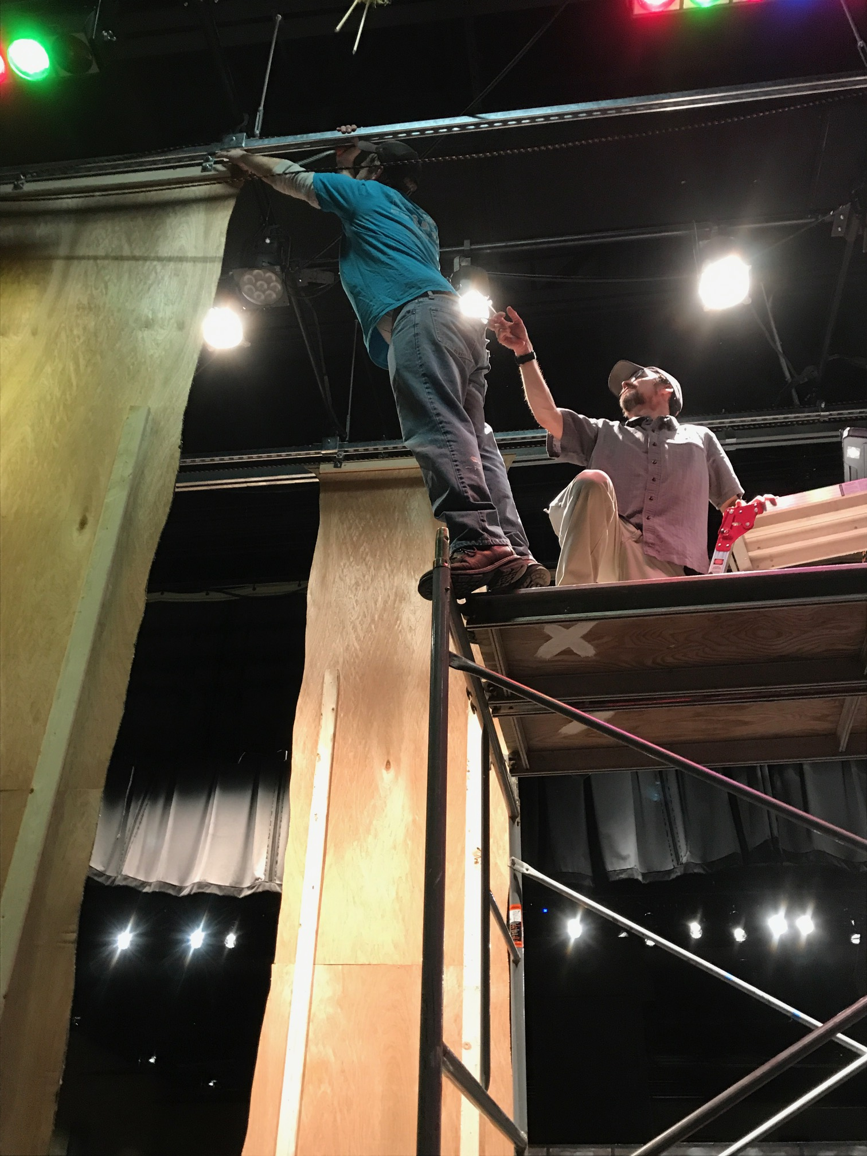
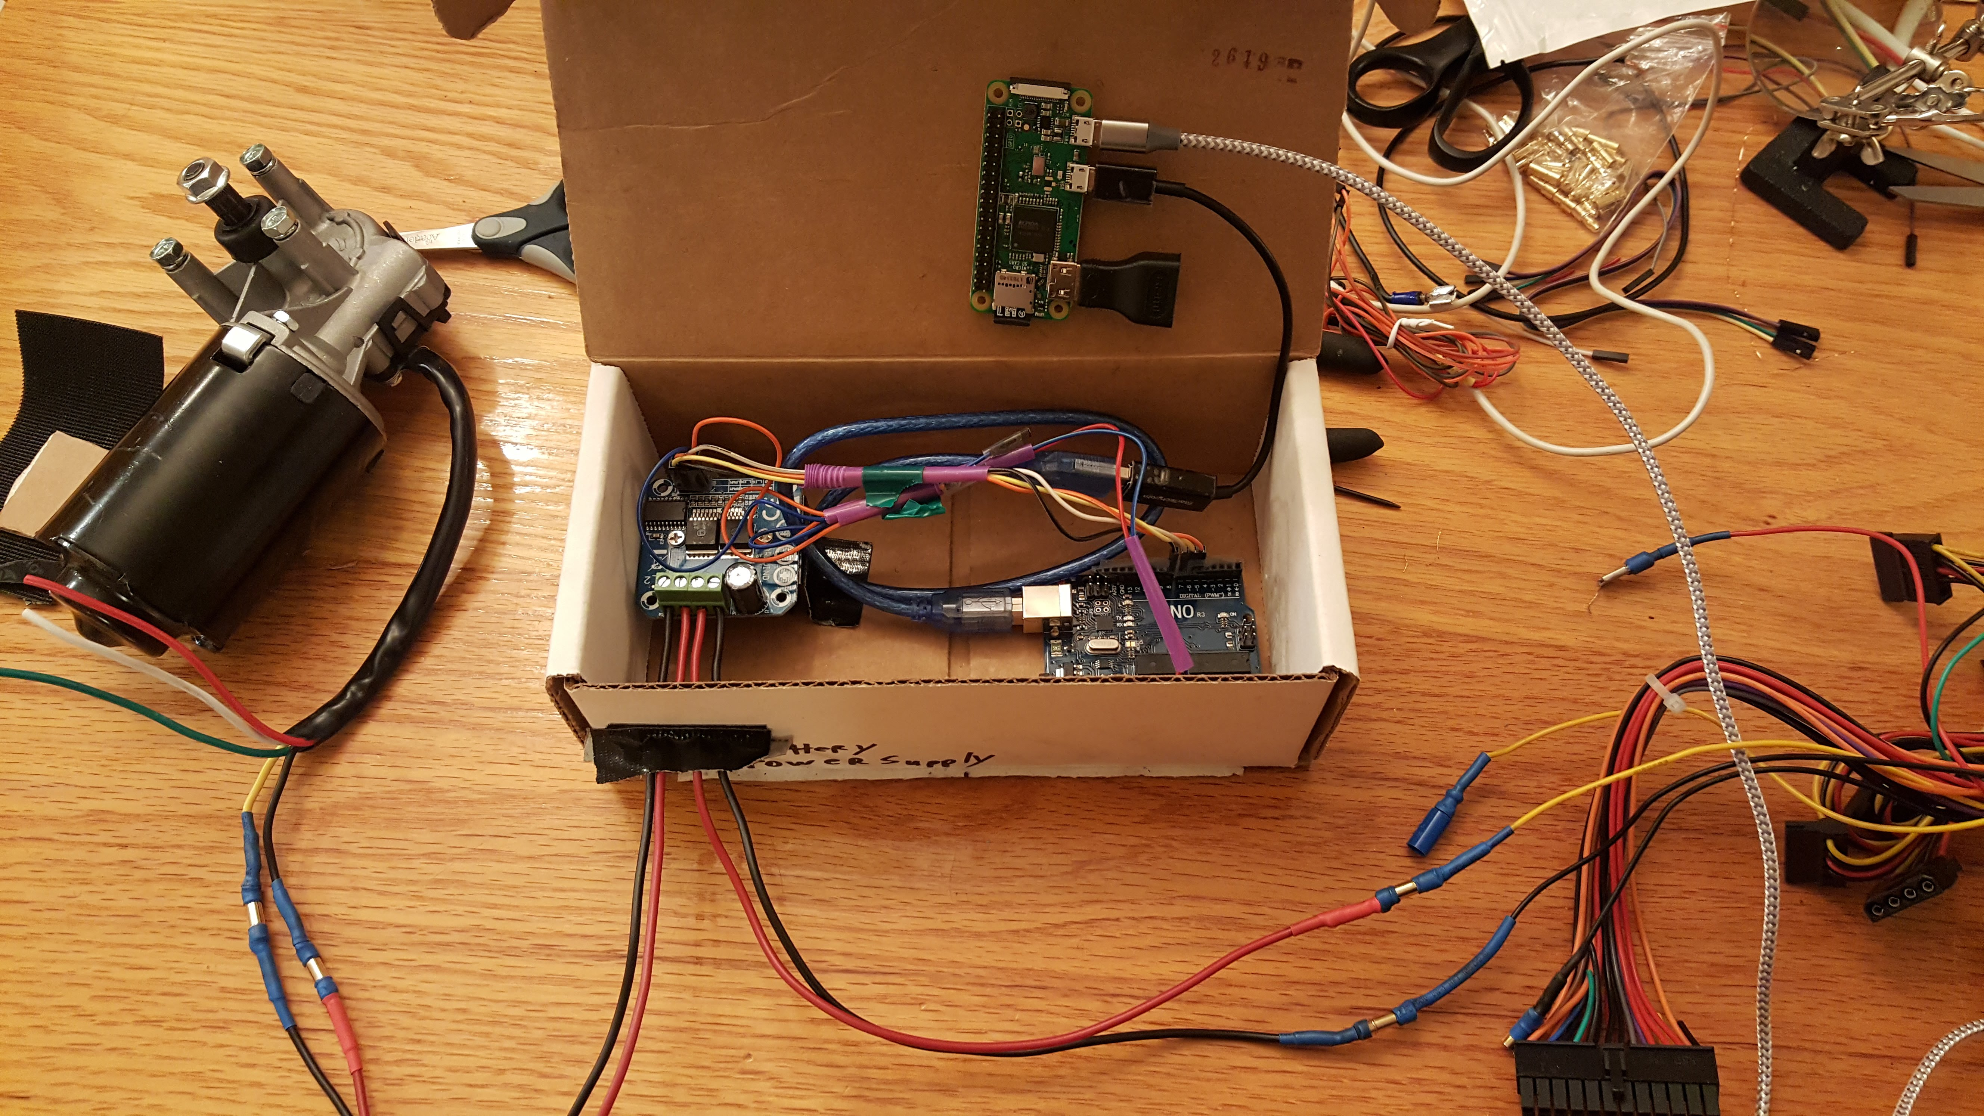
Latest Project

Slide 44
Moving Motors
Video of moving motors with Pi and Arduino using custom Mobile App:
https://photos.app.goo.gl/Vtt5InSJmdaWrx7m2
https://photos.app.goo.gl/1t9Jm3jFm6744uHn6

Slide 45
Latest Project
Video of Shrek Musical with Trees moving controlled by RaspberryPi’s and Arduino:
https://photos.app.goo.gl/KViCx3rYraSH2ih12

Slide 46

Lessons learned
I am now Less Dumb than I used to be!

Slide 47
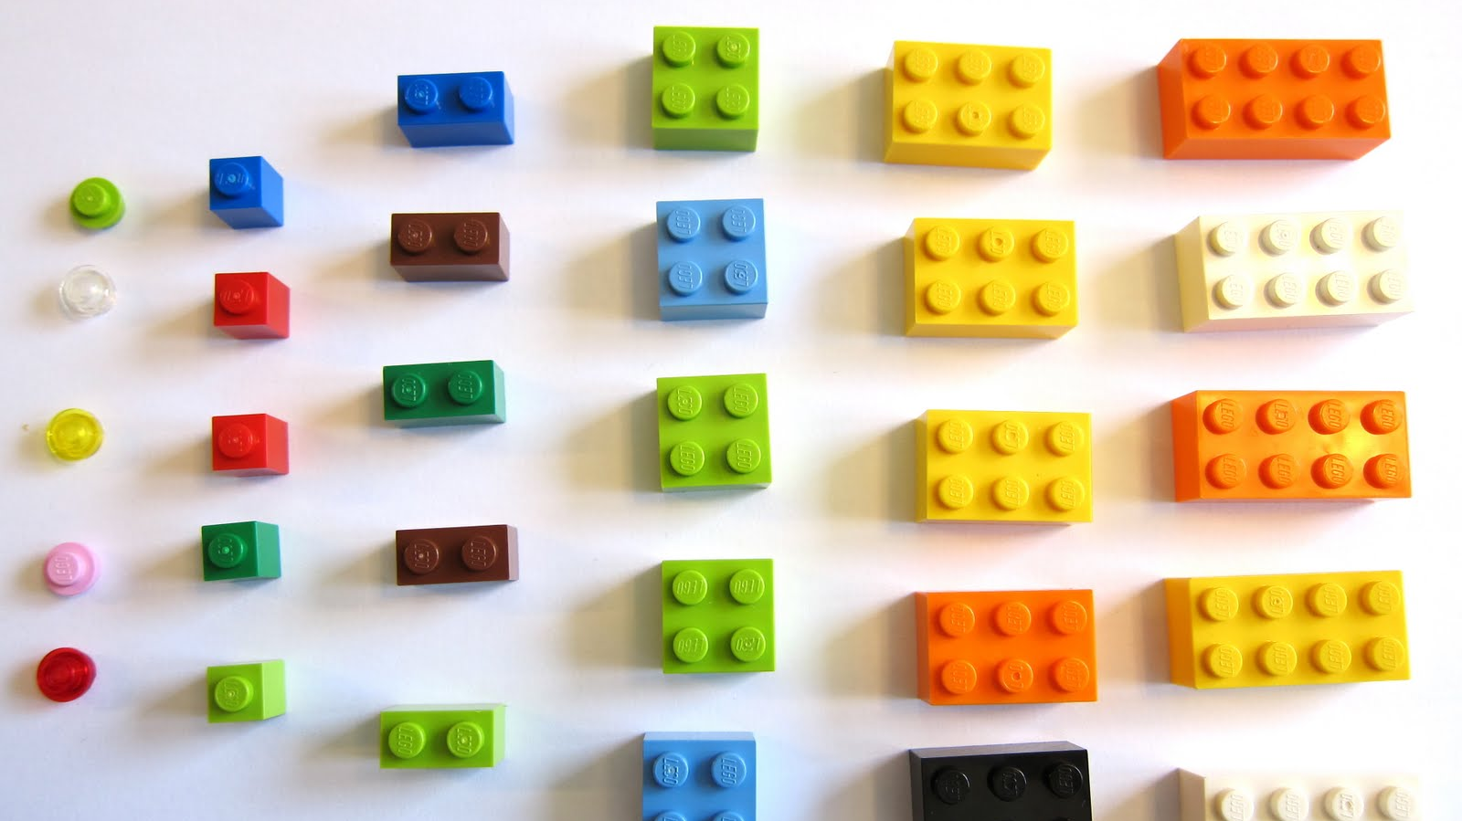
Break things down into smallest
components to test and learn.

Slide 48

Useful Tips
Prioritize
(Keep Focused)

Slide 49

Volt Meter
Get a Volt Meter and learn to use it… great for testing diodes (LED) and even transistors and just if pins are turning on and off like you expect.

Slide 50

Walk Away
Walk away.
Get a different perspective.
Rethink the problem.

Slide 51

Things Change… where to find help
Things change so fast, the first answer you find may not be new enough.
Library or OS you are using may be different than the tutorial you are reading.

Slide 52


Use the source
Use GitHub issues
Look at the Source Code
Examples
API’s
Configuration options
Commit your own code to somewhere! GitHub, GitLab, etc..

Slide 53


Document the things!

Slide 54
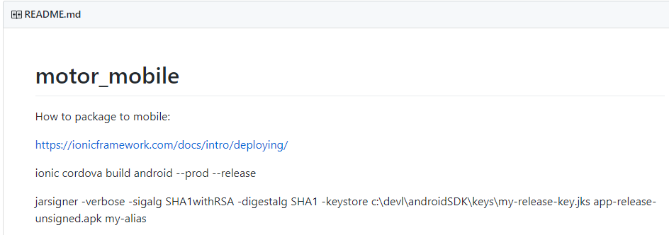
Document in ReaDMe.MD

Slide 55
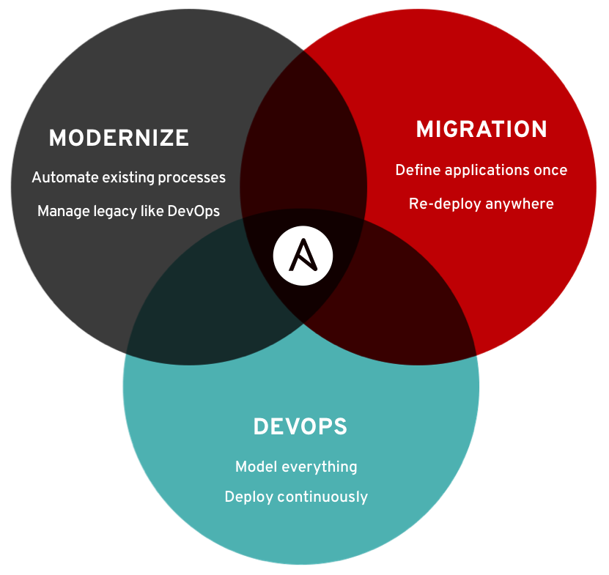
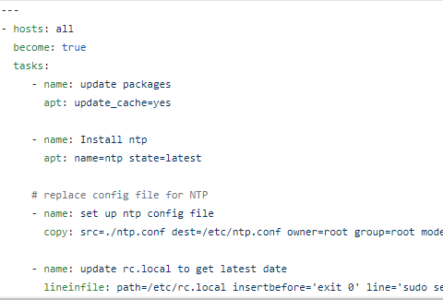
ScrIPT the Things! Ansible
Ansible Recipe for NTP setup

Slide 56
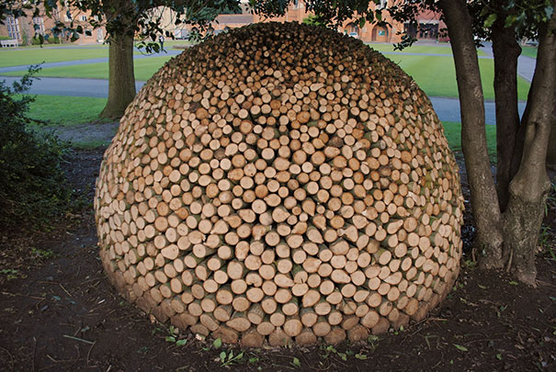
Things I wished I’d done or known
Centralized Logging
With distributed, headless projects centralized logs to capture errors would aide in troubleshooting.

Slide 57

Python is Best Suited for Most PI Projects
Python is the Best Around!
Most libraries for after market parts like Adafruits add-ons have Python libraries to make it easy to use them and examples…
Many Python Libraries for the Pi (like Adafruit libraries) rely on Python C extensions and Jython does not seem to support that.
Not as many resources for using other Languages.

Slide 58
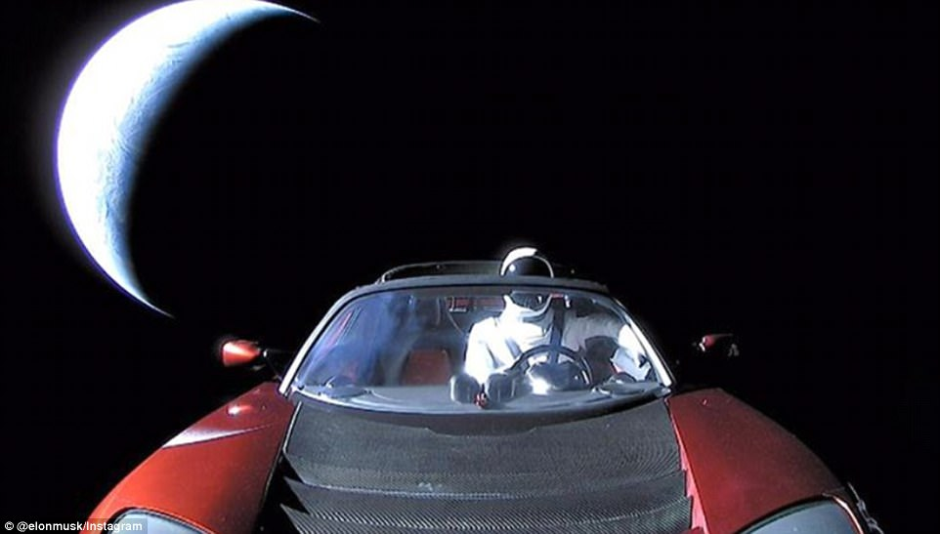
Innovation can take you places

Slide 59

Questions?
Come visit the Nationwide Booth near the concession area for an up close look or for more questions.
Contact me: btarlton@gmail.com
Slides: http://bit.ly/pipaintball

Slide 60
Resources
My Git Repo: https://github.com/javaplus
https://www.raspberrypi.org/
https://www.adafruit.com/
7 Segment Display:
https://www.adafruit.com/product/1270
https://chicagodist.com/products/adafruit-1-2-4-digit-7-segment-display-w-i2c-backpack-red
Sound Card for Pi Zero:
SYBA external USB Stereo Sound Adapter for Windows, Mac, Linux Extra Audio Source with Microphone SD-CM-UAUD
USB Speakers:
SUPVIN Portable Mini Clip-On USB Powered Stereo Multimedia Speaker Soundbar for Notebook Laptop PC Desktop Tablet Black
Battery Backup To Power Pi:
Aibocn Power Bank 10,000mAh External Battery Charger with Flashlight for Apple Phone iPad Samsung Galaxy Smartphones Tablet

Slide 61
Resources…
Banana Plugs:
Blulu 30 Pairs Banana Plug Male Female Bullet Connector Replacements for ESC Battery and Motors, Golden (3.5 mm)
H-Bridge:
Double BTS7960B DC 43A Stepper Motor Driver H-Bridge PWM Driver Board Module for Arduino Smart Car
Instructions for H Bridge:
http://www.instructables.com/id/Motor-Driver-BTS7960-43A/
Remote Control with Arduino:
https://www.sparkfun.com/tutorials/348

